Slide 1

Special Investigation of Compliance with Section 86 of the FPPR
The devil is in the details
Are we getting RESULTS?

Slide 2

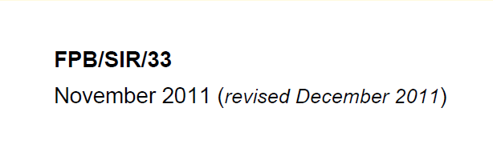

Slide 3
Outline
DNI Examples
DNI Examples
Summary of compliance assessment
  Update of forest cover inventory
  Wildlife Tree Retention Areas
  Resource Features, Wildlife Features, and Roads
Who uses the reporting system (RESULTS)
  People
  Other government information systems
An example of implications:
  Estimates of Area harvested
Strategic issues and Recommendations

Slide 4
Outline
Summary of compliance assessment
  Update of forest cover inventory
  Wildlife Tree Retention Areas
  Resource Features, Wildlife Features, and Roads
Who uses the reporting system (RESULTS)
  People
  Other government information systems
An example of implications:
  Estimates of Area harvested
Strategic issues and Recommendations

Slide 5
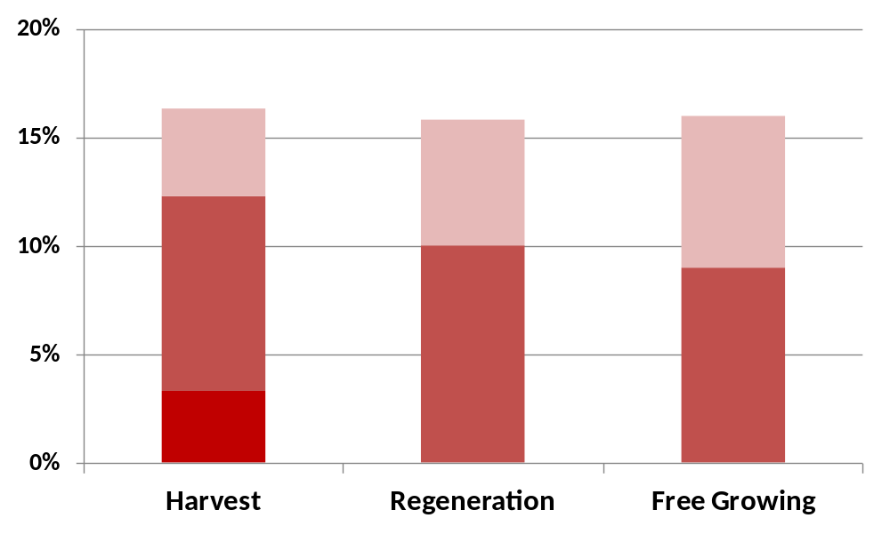
Non-compliance with requirement to update forest cover inventory
Percent
Non
-
Compliance
“Bad”
Map
Late
or
No
Map
No
Report
Requirement at:

Slide 6
Reporting of Wildlife Tree Retention Areas
Compliance assessment was not possible because Reserve_Objective codes are ambiguous about how to report WTRAs.
We assessed compliance with requirement to report Reserve_Type:
  Both “Group” and “Dispersed”

Slide 7
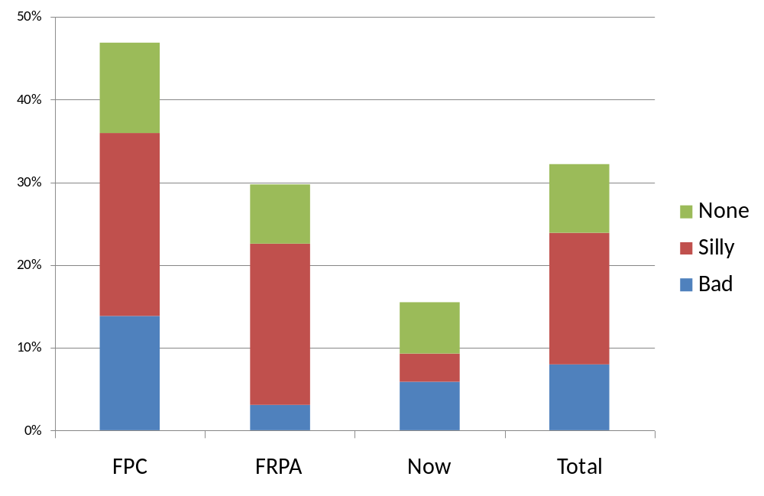
Reporting of Group (G) Reserves*
Percent
Non-Compliance
Type of
Coding Error
- Unharvested but no “G”
- “G” but no residual trees
- “G” but no objective
*after retirement of obsolete reserve types (2009/12/01)
Harvested Before
Reporting Period
Harvested During
Reporting Period

Slide 8
Reporting of Dispersed (D) Reserves*
80%
non-compliance
*after retirement of obsolete reserve types (2009/12/01)

Slide 9
DNI Reserve Reporting
Reserve Type | Area (000’s ha) | Percent
Blank or None | 44 | 82%
Old Code (W,O,R) | 4 | 7%
Group | 6 | 10%
Dispersed | <1 | <1%
Total Forest Cover | 54

Slide 10
DNI Reserve Type “G” Issues
Total MAT or G 6,440 ha
Issue | Area (ha) | % of Total
Unharvested but no "G“ (and no SU) | 40 | 1%
"G" but No Residual Trees | 490 | 8%
"G" but No Objective | 568 | 9%
All Issues | 1,097 | 17%

Slide 11
Resource Features, Wildlife Features, and Roads
Resource Features and Wildlife Features:
  There is no “form and manner” of reporting.
Roads
  There is no reporting of roads, outside of cutblocks
    Sections 86(2) and 86(4) repealed in 2008
  Reporting of roads inside of cutblocks has several issues.

Slide 12
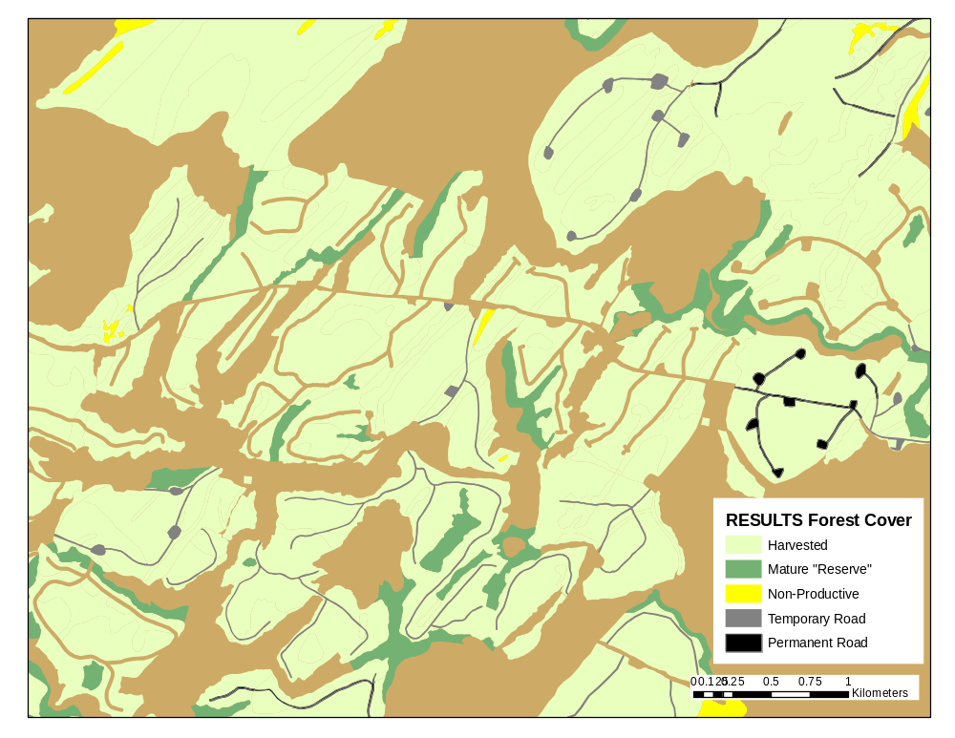

Slide 13
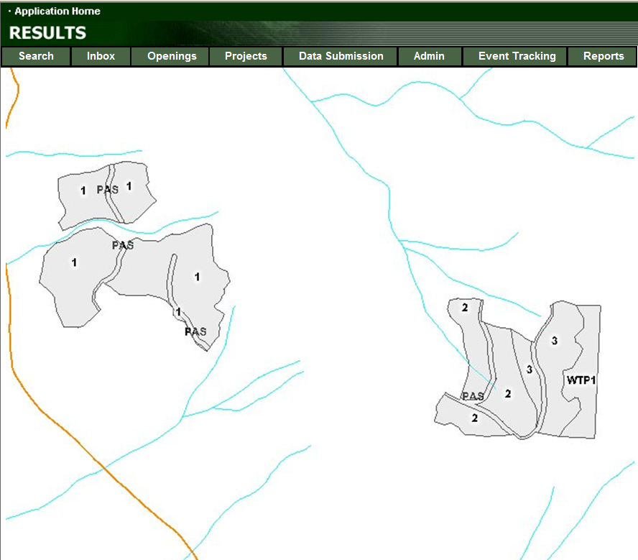
DNI Example 1

Slide 14
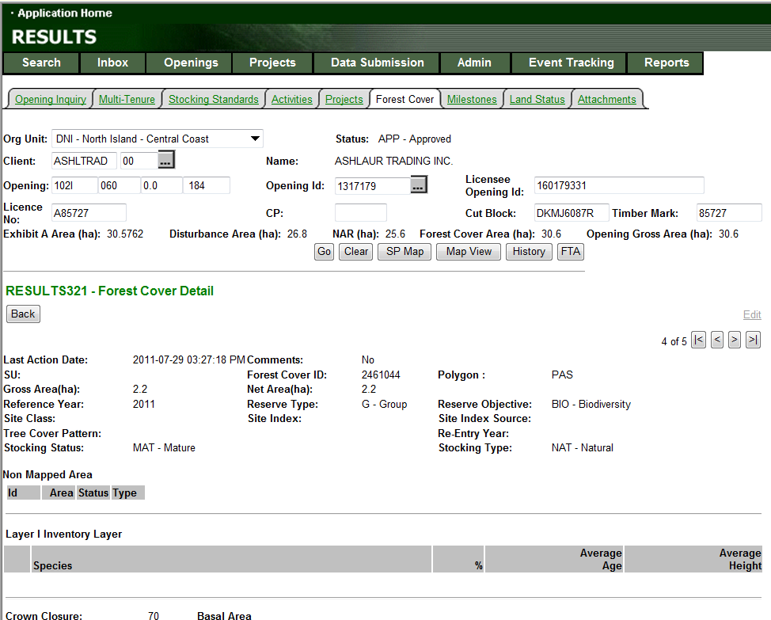
DNI Example 1

Slide 15
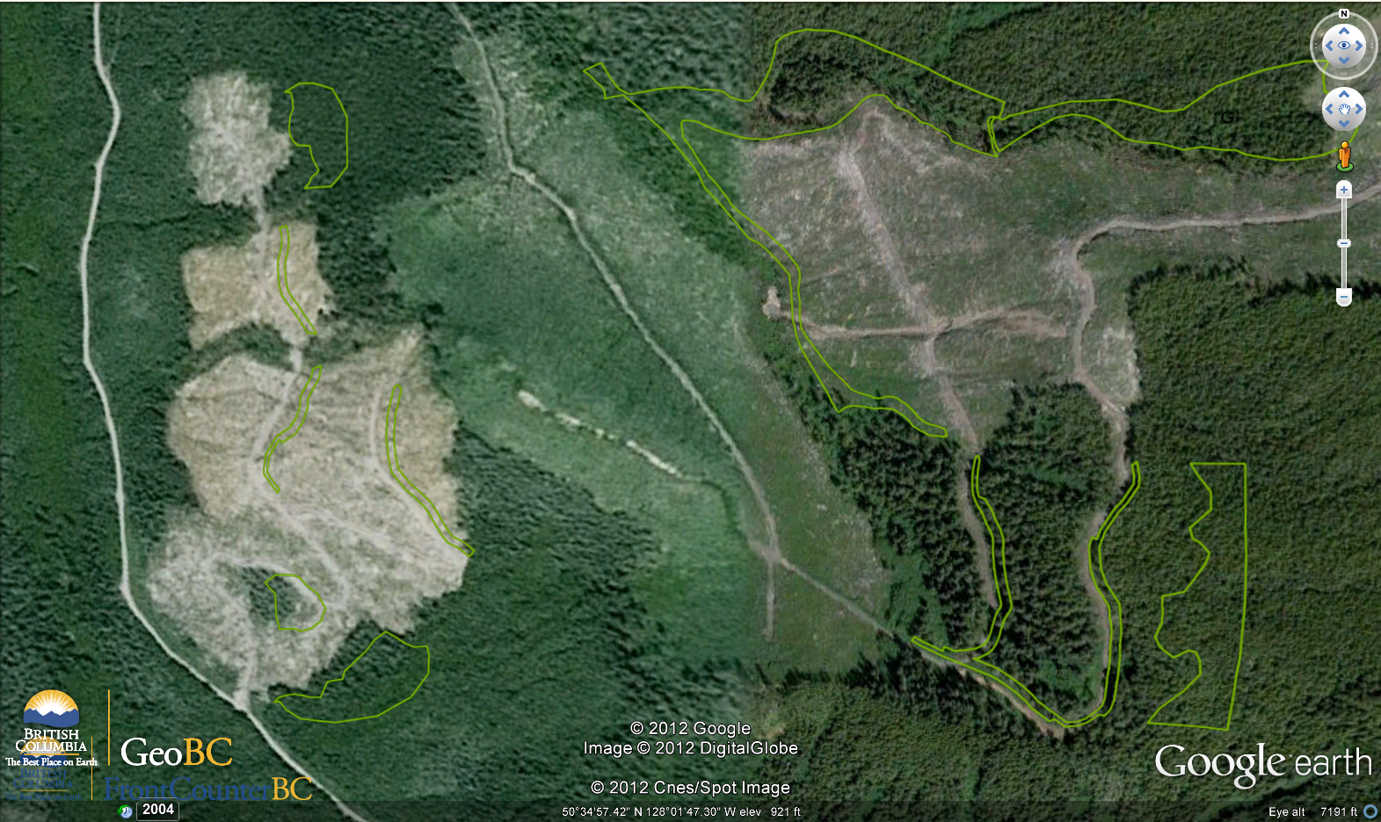
DNI Example 1

Slide 16
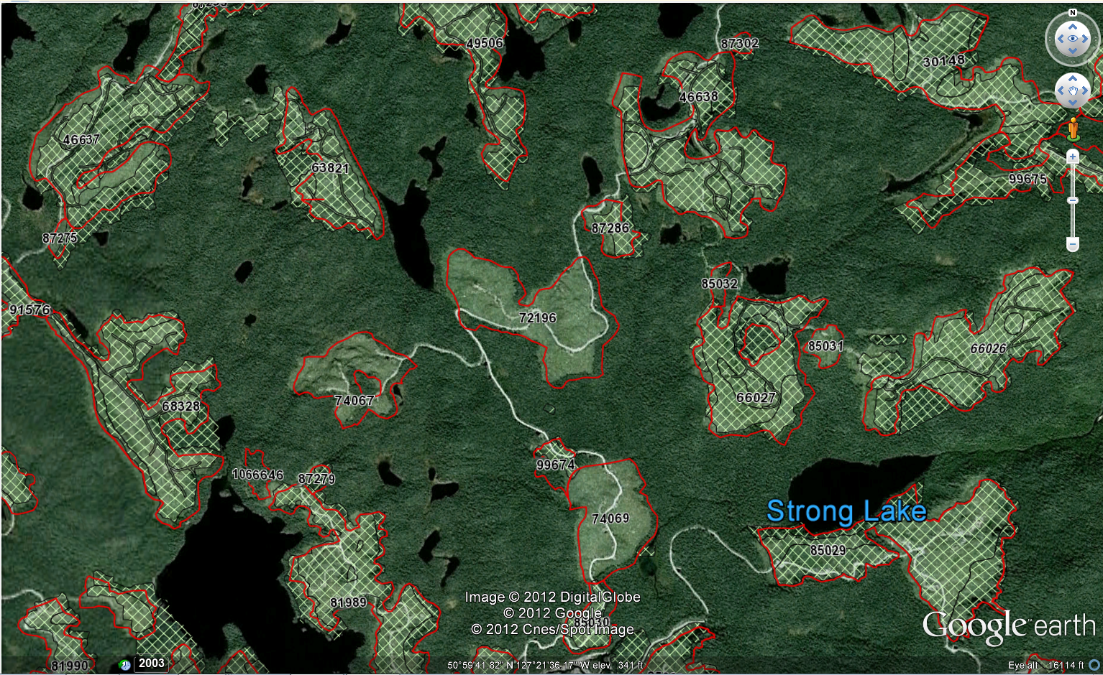
DNI Example 2

Slide 17
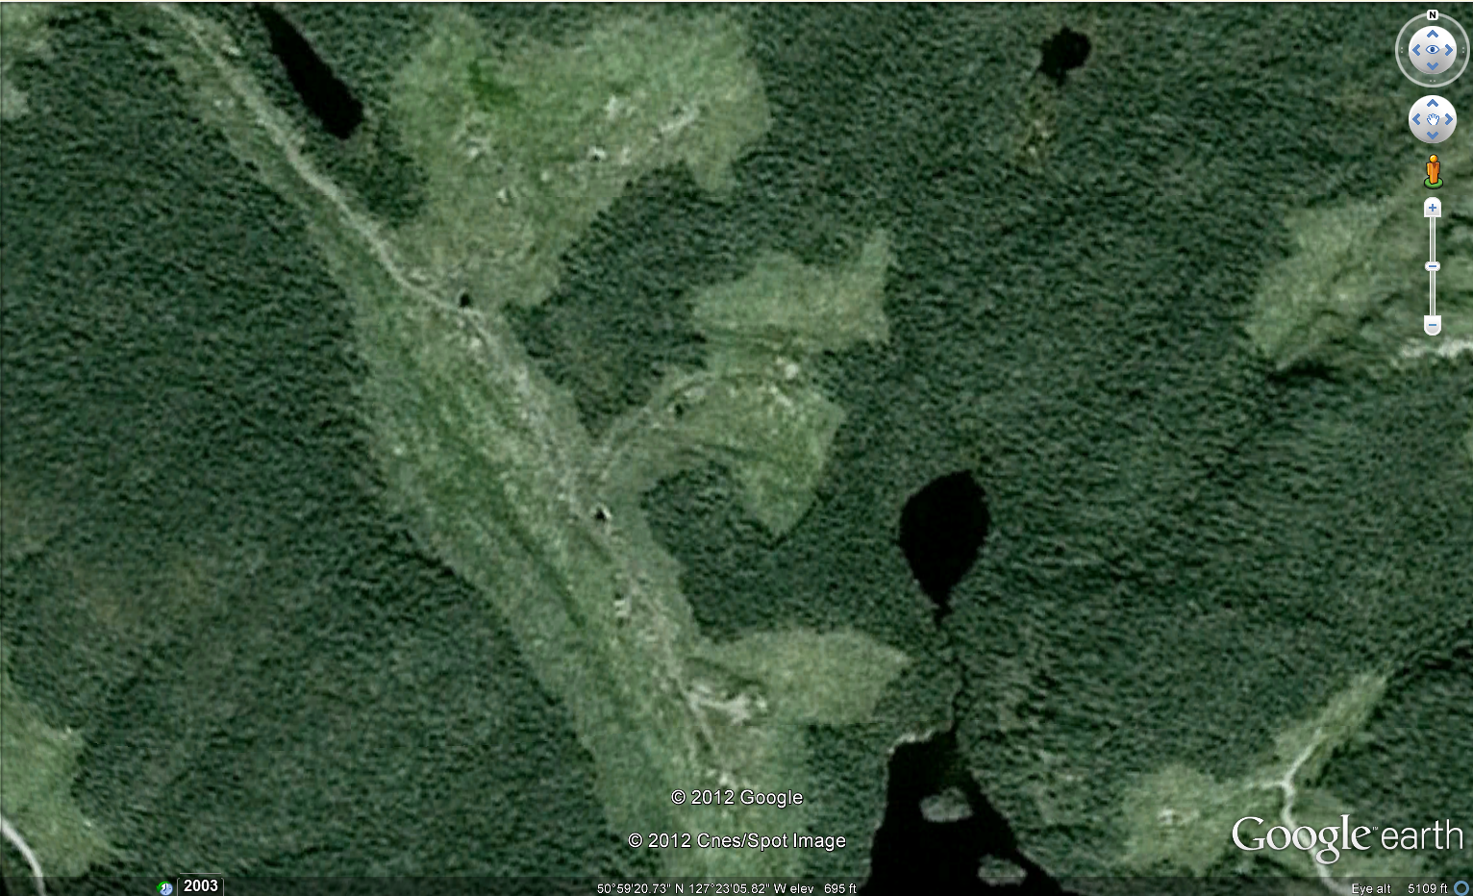
DNI Example 2

Slide 18
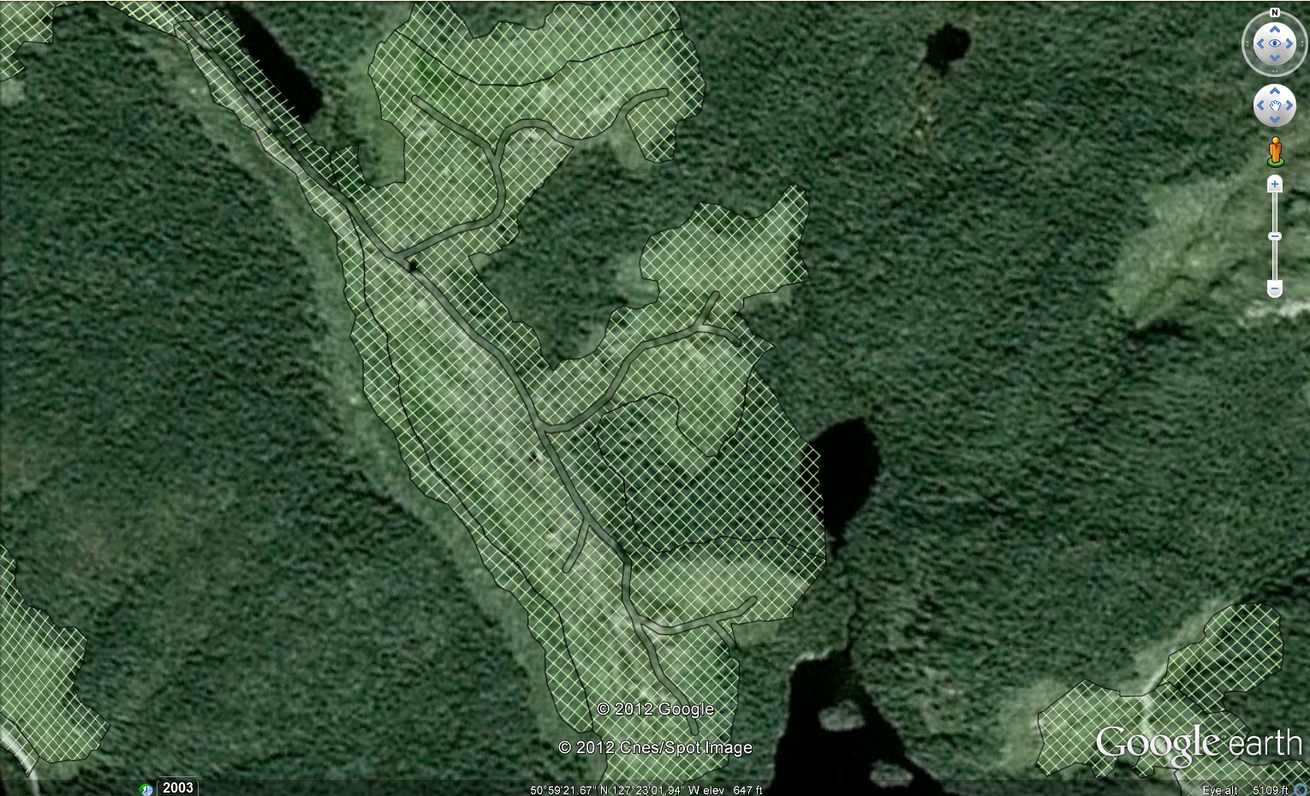
DNI Example 2

Slide 19
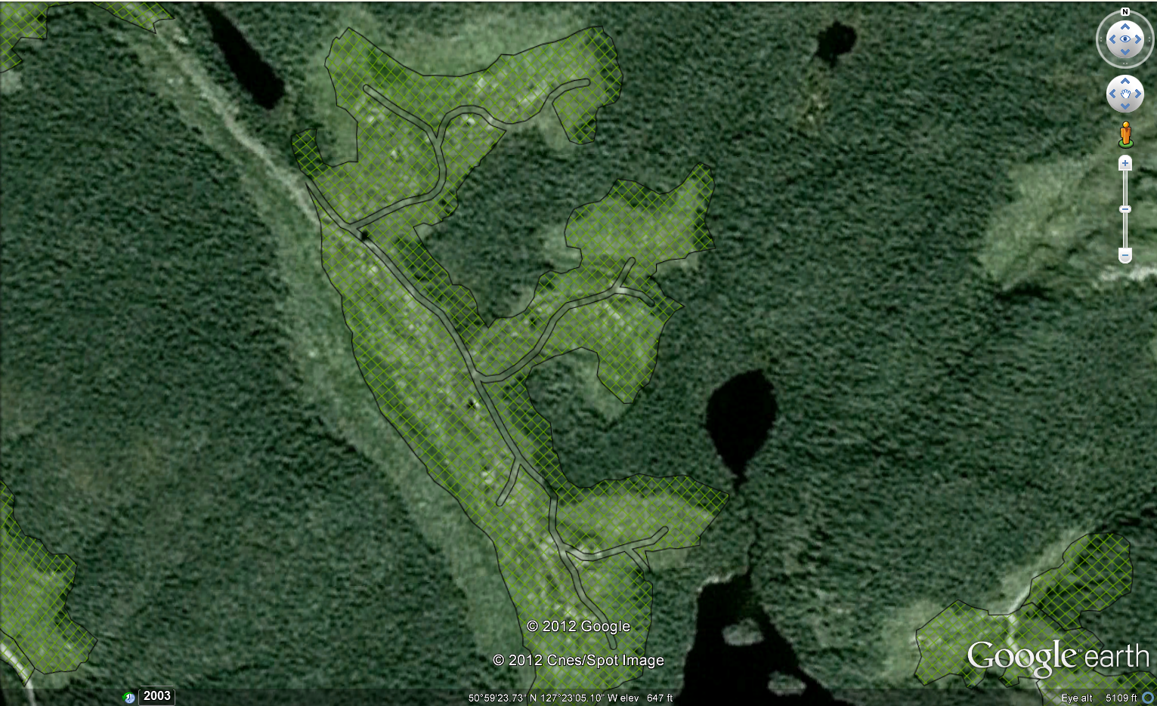
DNI Example 2

Slide 20
Outline
Summary of compliance assessment
  Update of forest cover inventory
  Wildlife Tree Retention Areas
  Resource Features, Wildlife Features, and Roads
Who uses the reporting system (RESULTS)
  People
  Other government information systems
An example of implications:
  Estimates of Area harvested
Strategic issues and Recommendations

Slide 21
People who use RESULTS
Agreement holders (and service providers) use RESULTS to comply with section 86.
C&E (and auditors) identify populations.
Analysts (notably timber supply) mine data.
Forest For Tomorrow & a few others do day-to-day management of on-the-ground activities.

Slide 22
Linkages to Other
Government Information Systems
CIMS: Compliance Information Management System
CRS: Corporate Reporting System
FREPIMS: Forest & Range Evaluation Program Info. Mgmt. System
FSPTS: Forest Stewardship Plan (FSP) Tracking System
FTAS: Forest Tenures and Administration System
ILRR: Integrated Land and Resource Registry
iMapBC: GeoBC MapView web mapping application
LRDW: Land and Resource Data Warehouse
SPAR: Seed Planning and Registry Application
VRIMS: Vegetation Resources Inventory Management System

Slide 23
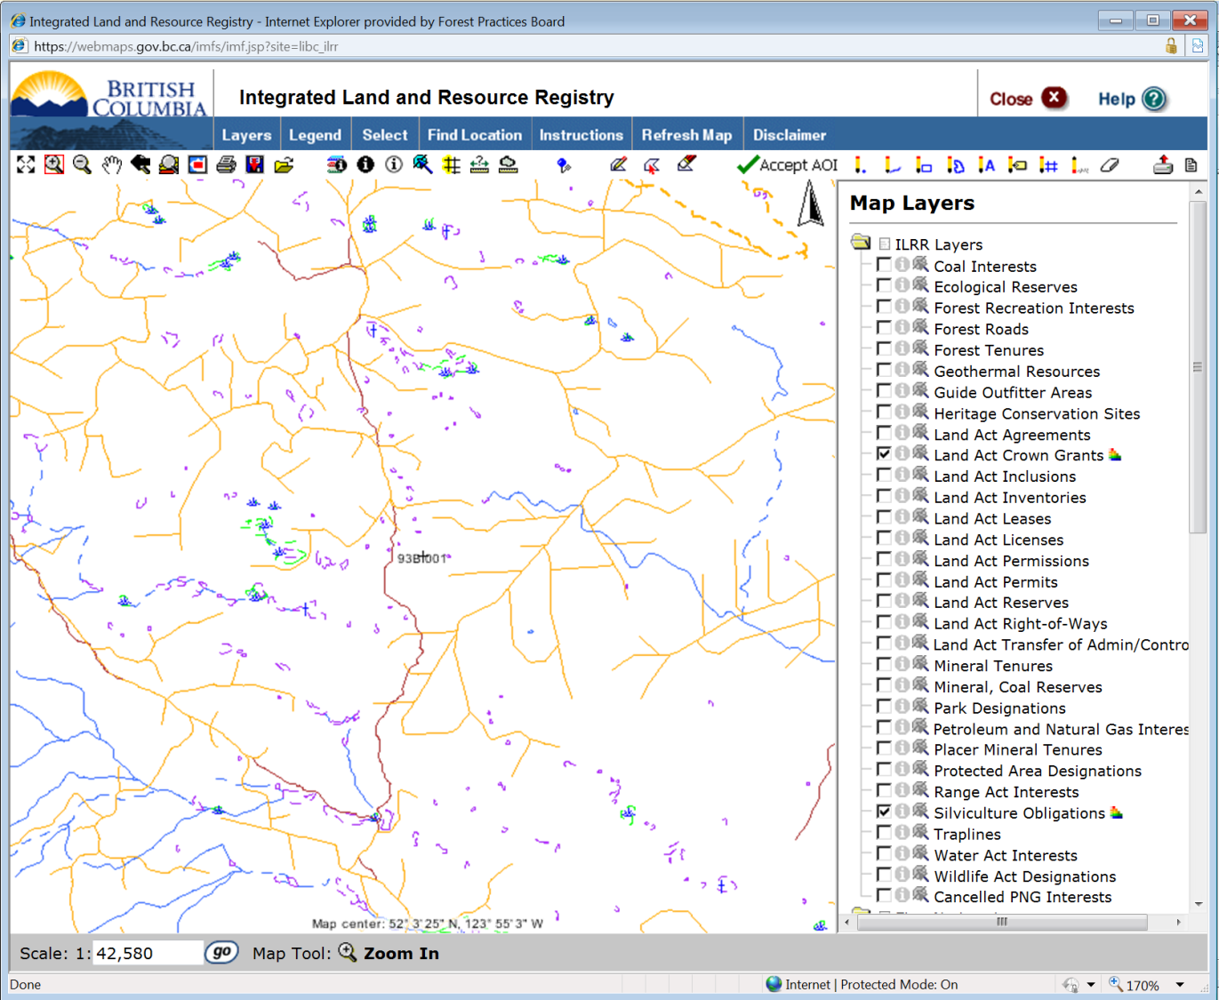

Slide 24


Linkages to Other
Government Information Systems
CIMS: Compliance Information Management System
CRS: Corporate Reporting System
FREPIMS: Forest & Range Evaluation Program Info. Mgmt. System
FSPTS: Forest Stewardship Plan (FSP) Tracking System
FTAS: Forest Tenures and Administration System
ILRR: Integrated Land and Resource Registry
iMapBC: GeoBC MapView web mapping application
LRDW: Land and Resource Data Warehouse
SPAR: Seed Planning and Registry Application
VRIMS: Vegetation Resources Inventory Management System
Obsolete Reserves
Obsolete Reserves
Obsolete Reserves
Obsolete Reserves
Obsolete Reserves

Slide 25
Details about usage
3.2.3
3.2.4
3.2.5
Other reporting issues
Information in RESULTS that may be of little or no use
Issues making RESULTS information difficult to use

Slide 26
Outline
Summary of compliance assessment
  Update of forest cover inventory
  Wildlife Tree Retention Areas
  Resource Features, Wildlife Features, and Roads
Who uses the reporting system (RESULTS)
  People
  Other government information systems
An example of implications:
  Estimates of Area harvested
Strategic issues and Recommendations

Slide 27
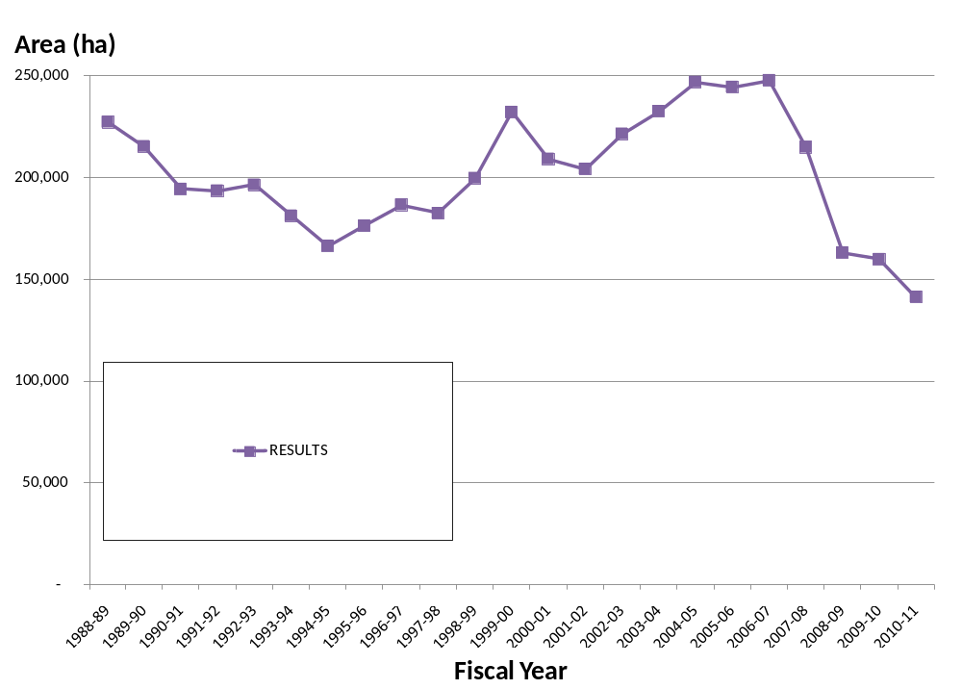
Estimates of Area Harvested

Slide 28
Estimates of Area Harvested
Area (ha)
250,000
200,000
150,000
100,000
RESULTS
50,000
"Forest Service" Annual Report
-
Fiscal Year

Slide 29
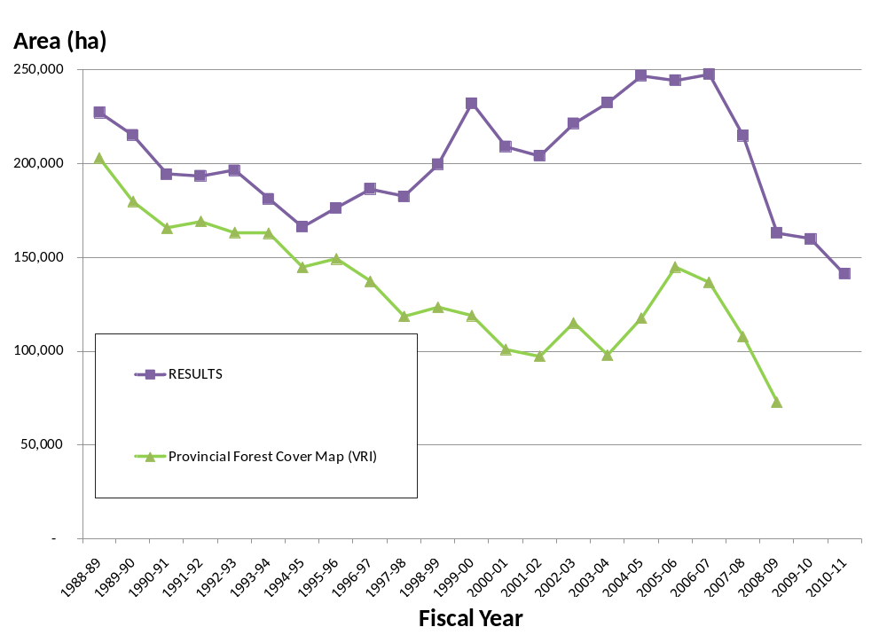
Estimates of Area Harvested

Slide 30
Outline
Summary of compliance assessment
  Update of forest cover inventory
  Wildlife Tree Retention Areas
  Resource Features, Wildlife Features, and Roads
Who uses the reporting system (RESULTS)
  People
  Other government information systems
An example of implications:
  Estimates of Area harvested
Strategic issues and Recommendations

Slide 31
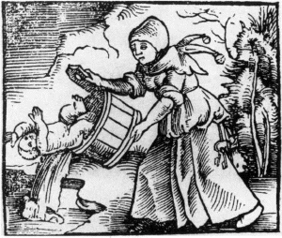

Slide 32
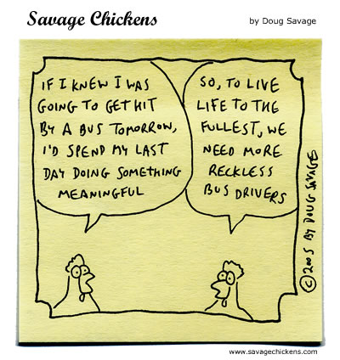

Slide 33
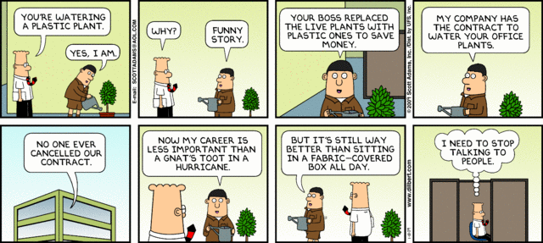

Slide 34
Reporting Requirements
Then
(Command & Control)
Now
(Results-Based Mgmt.)
What are your plans?
How is it going?
  Is it going ok?
  Is it going ok?
What happened?
What happened?

Slide 35
Recommendations
A reporting system for road construction and deactivation; outside of cutblocks.
A needs analysis of reporting under section 86, and subsequent changes.
A less expensive, more flexible option for the reporting system.
Until recommendations 2 and 3 are acted upon;
  a comprehensive quality control system for RESULTS (enforce submission of basic legal requirements), and
  improved the documentation and training for RESULTS.

Slide 36
